Slide 1


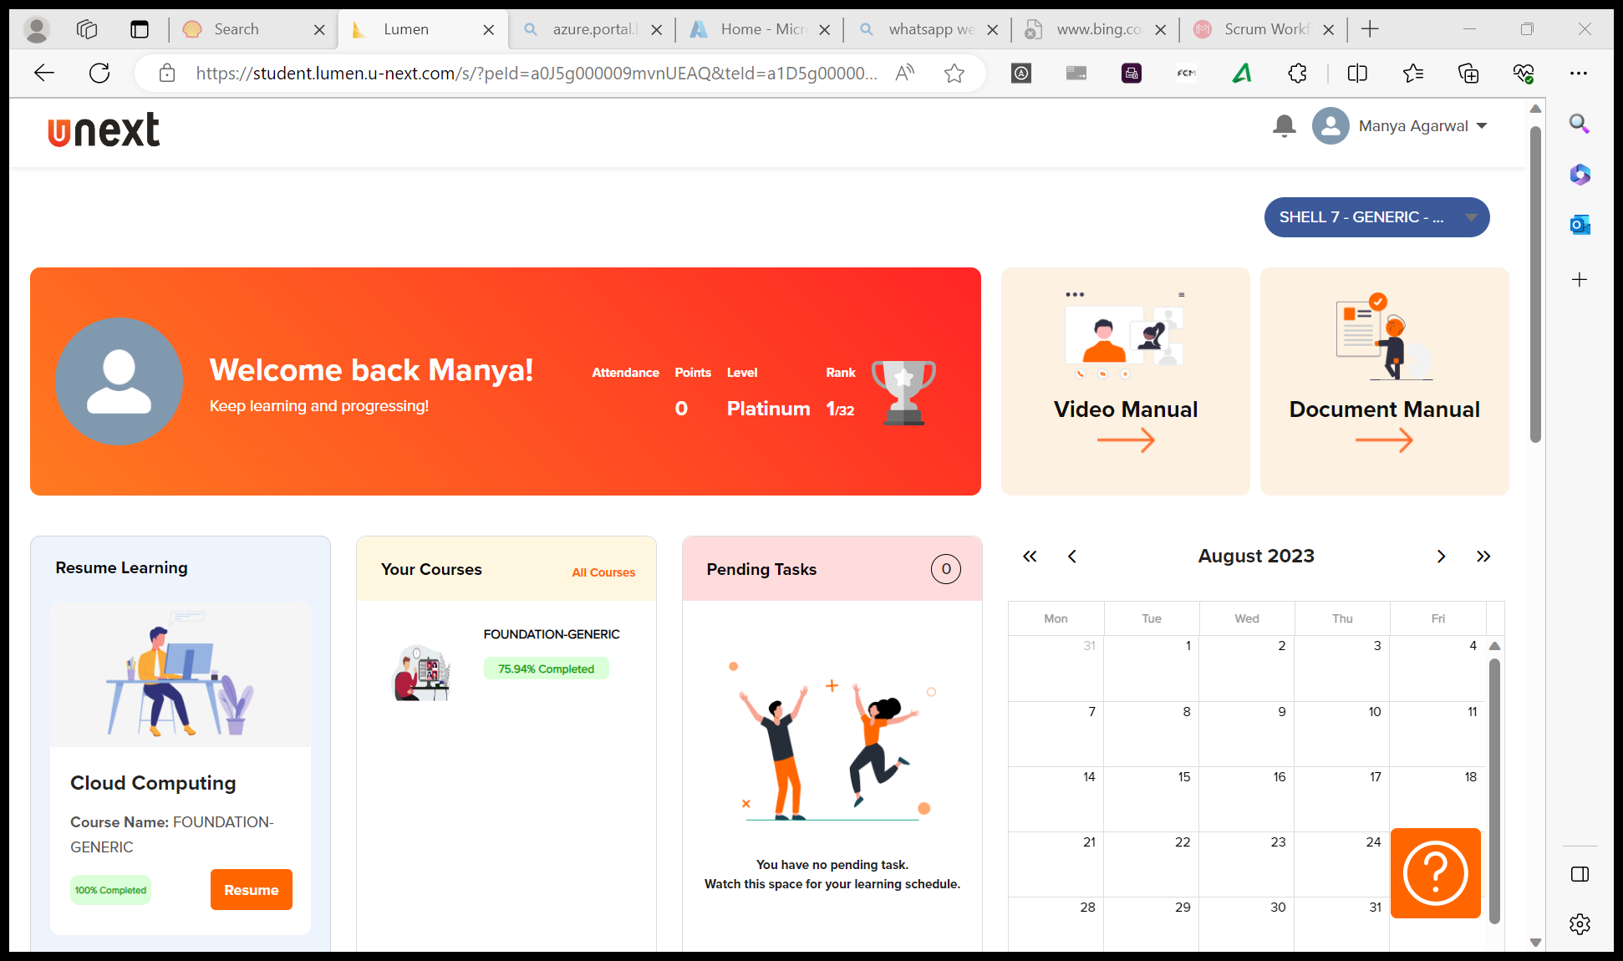
Journey Presentation
Submitted By:
Manya Agarwal
Employee No. : 654801

Slide 2
Journey Presentation Week-4

Slide 3
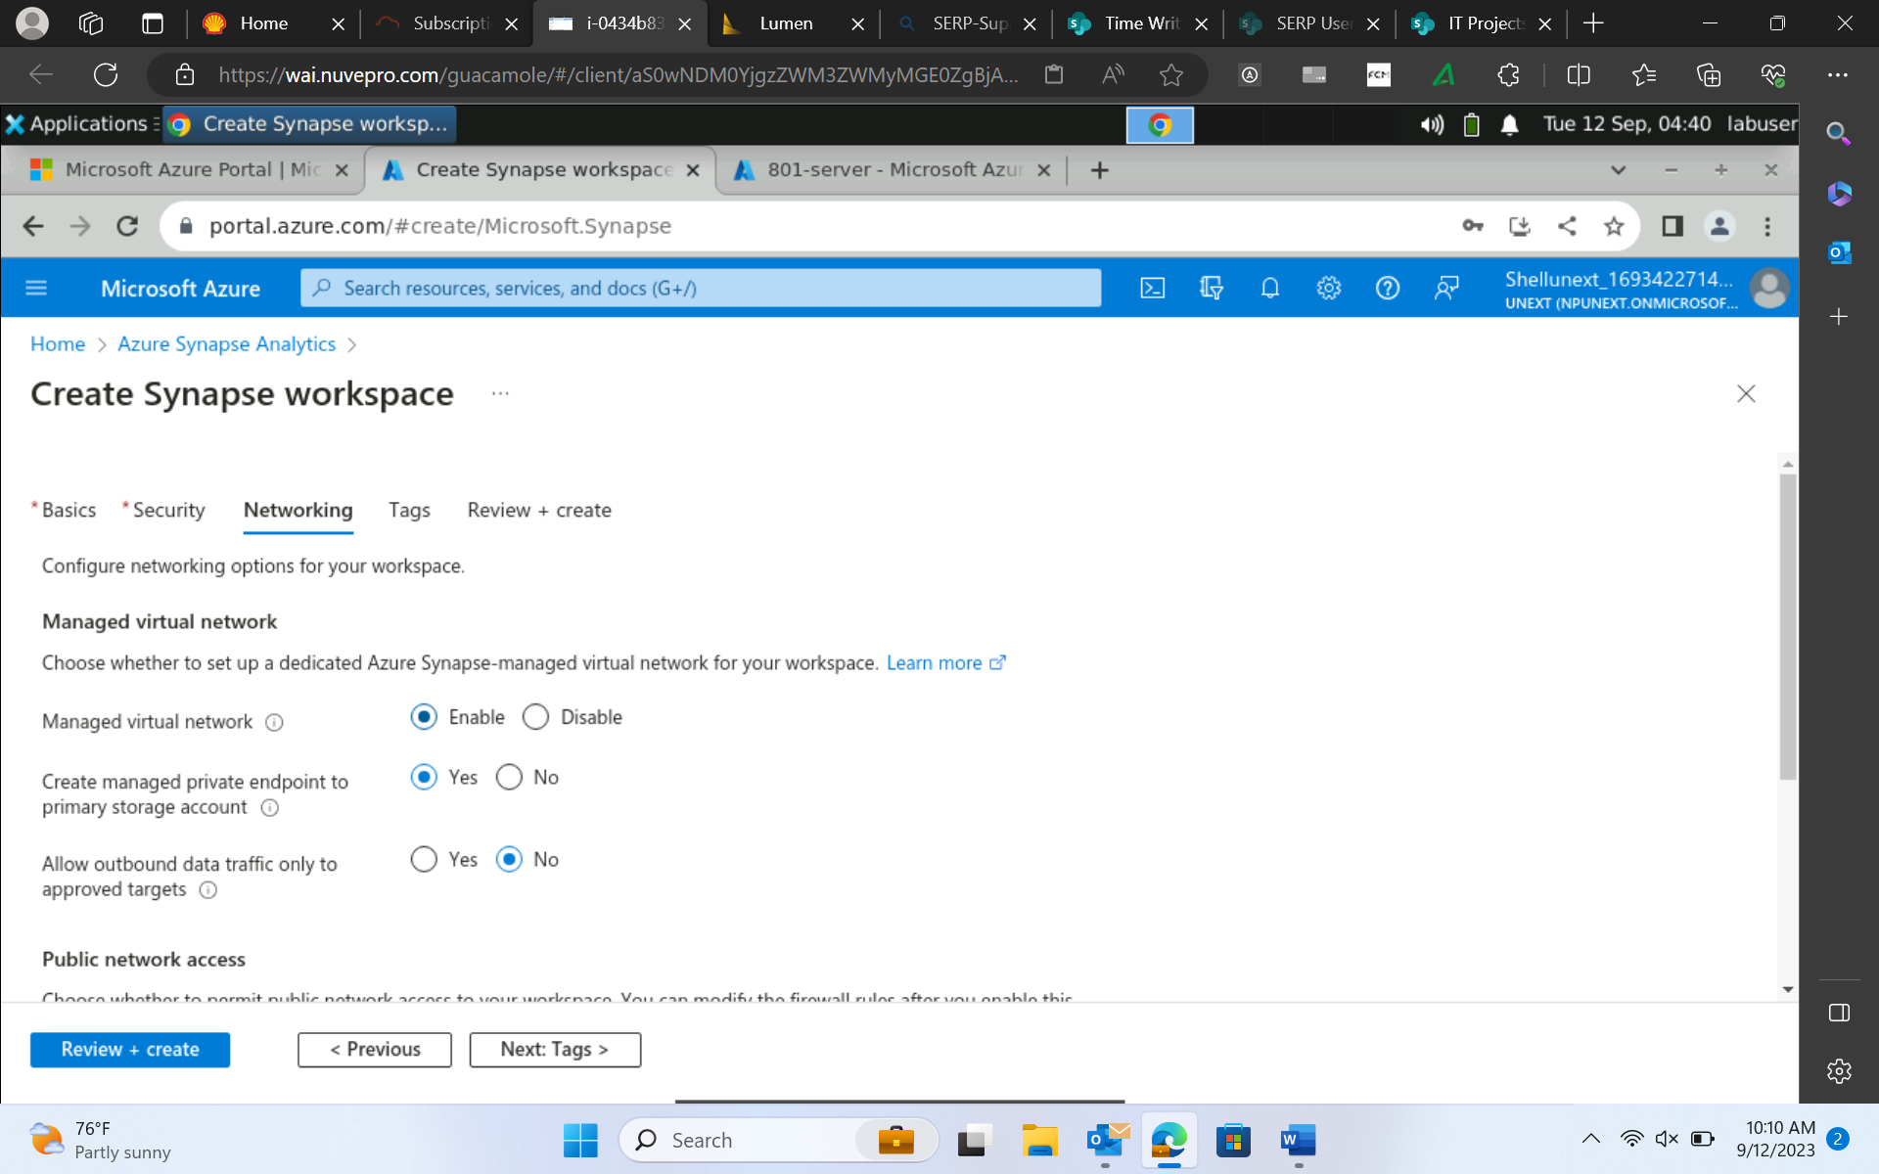
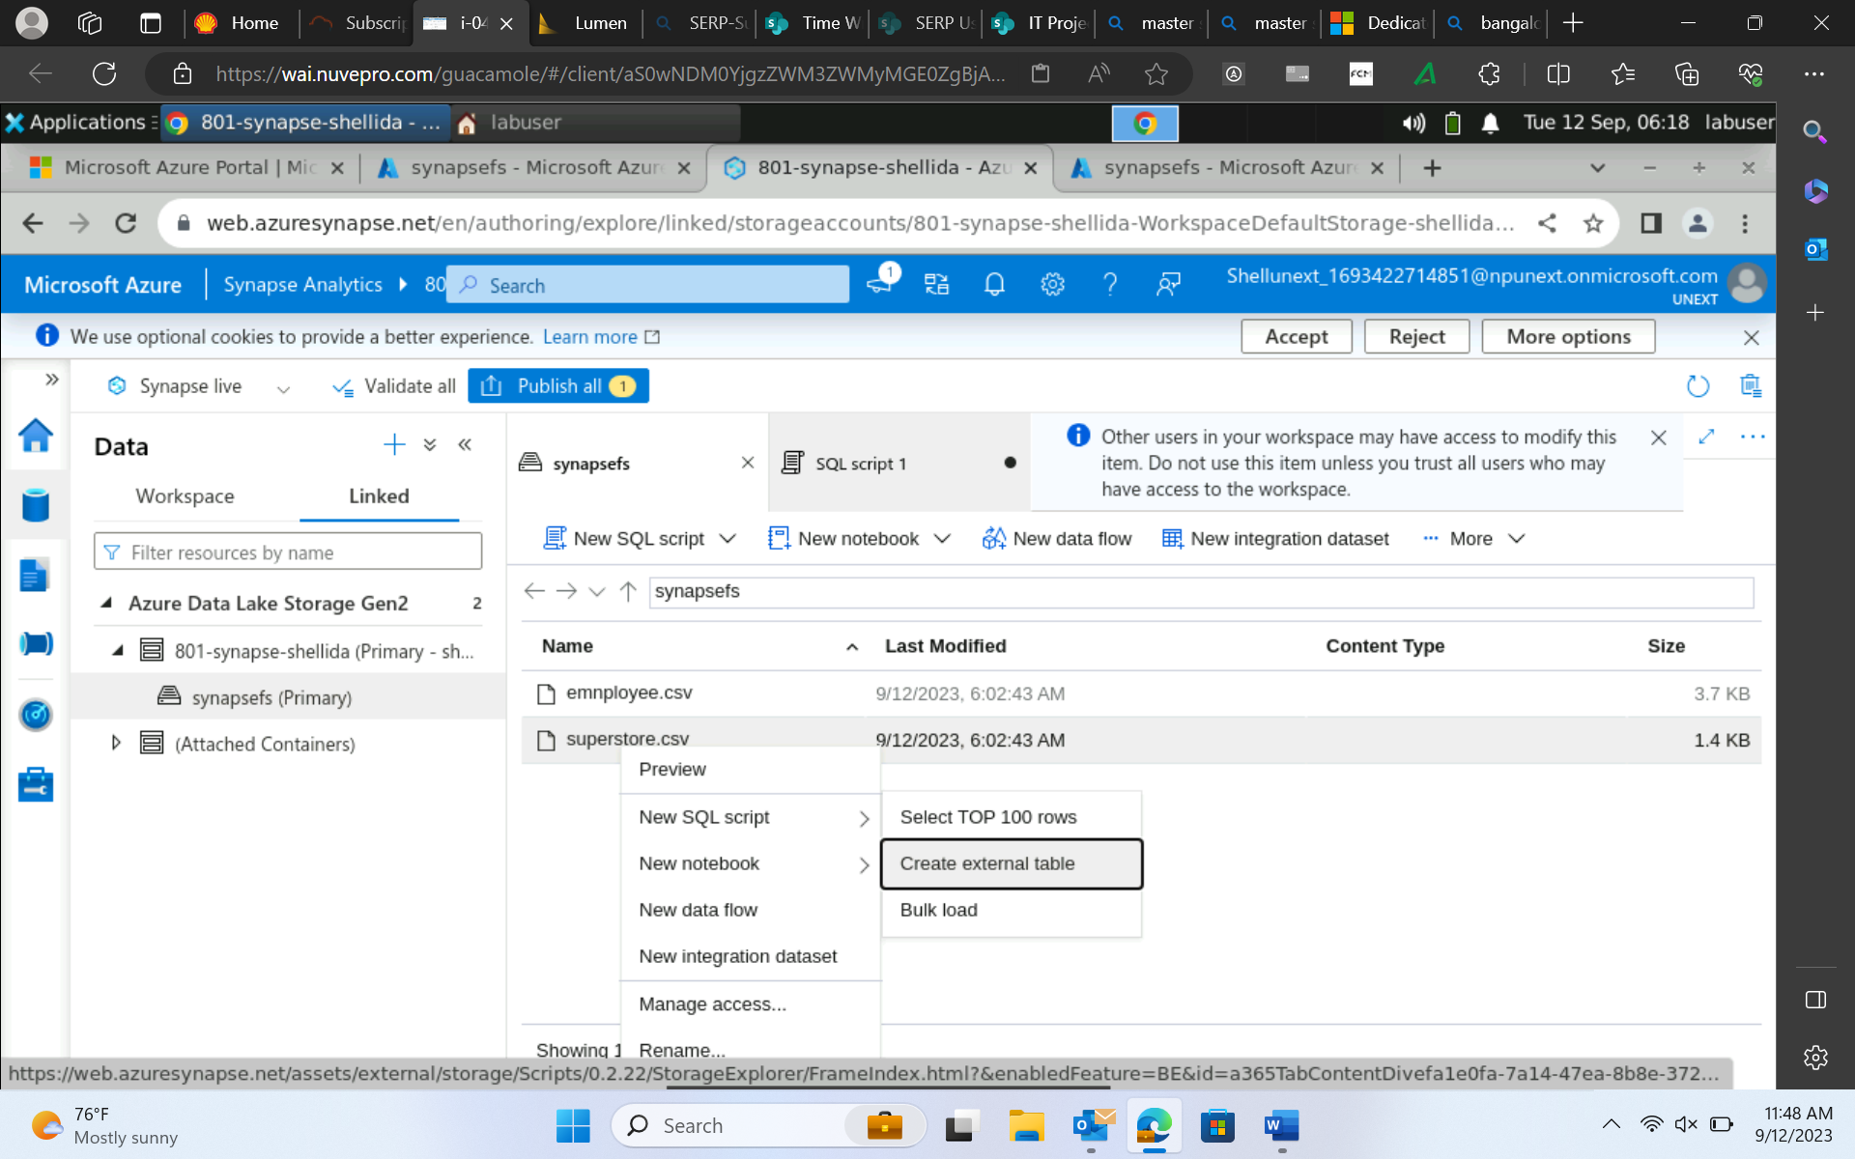
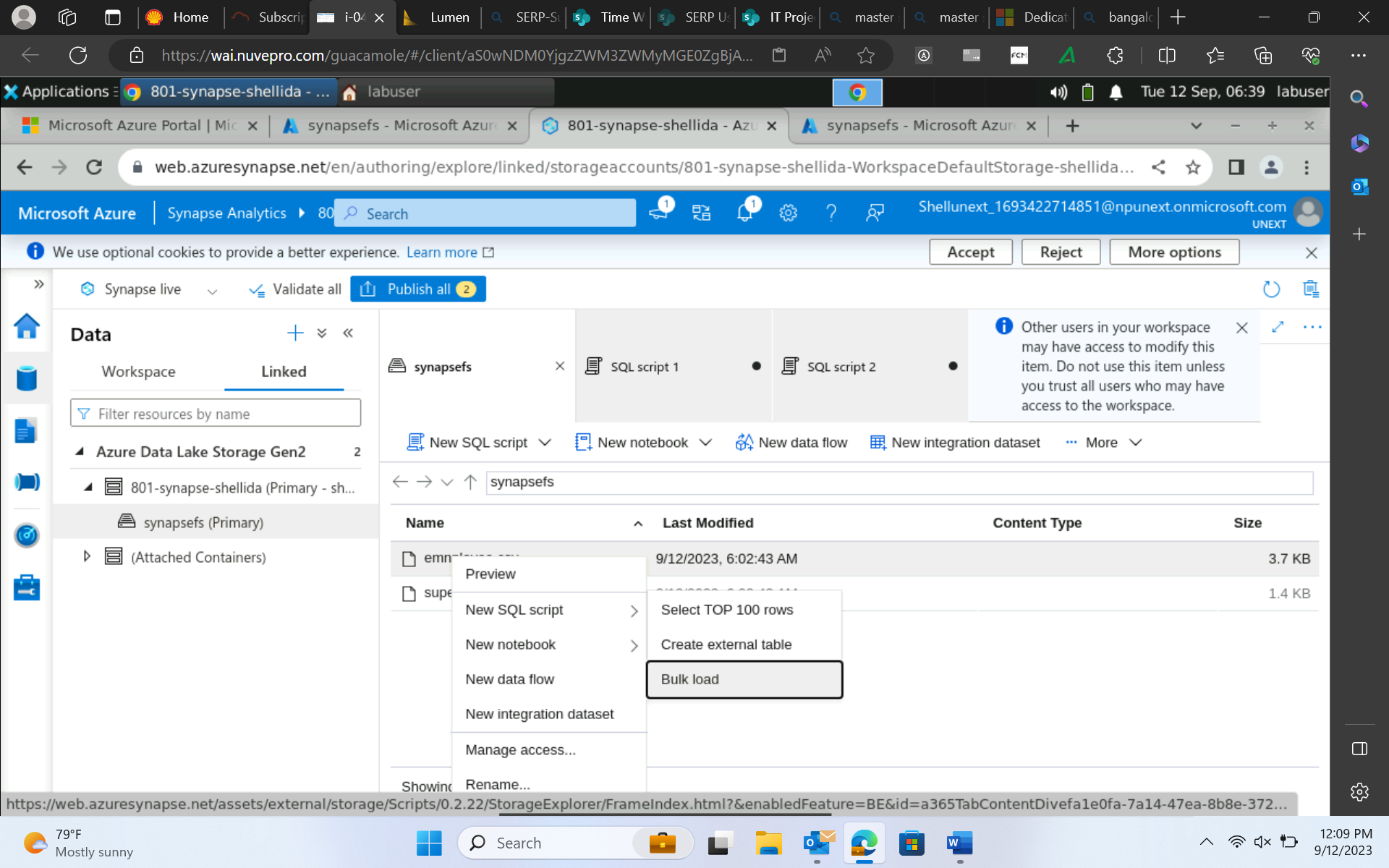
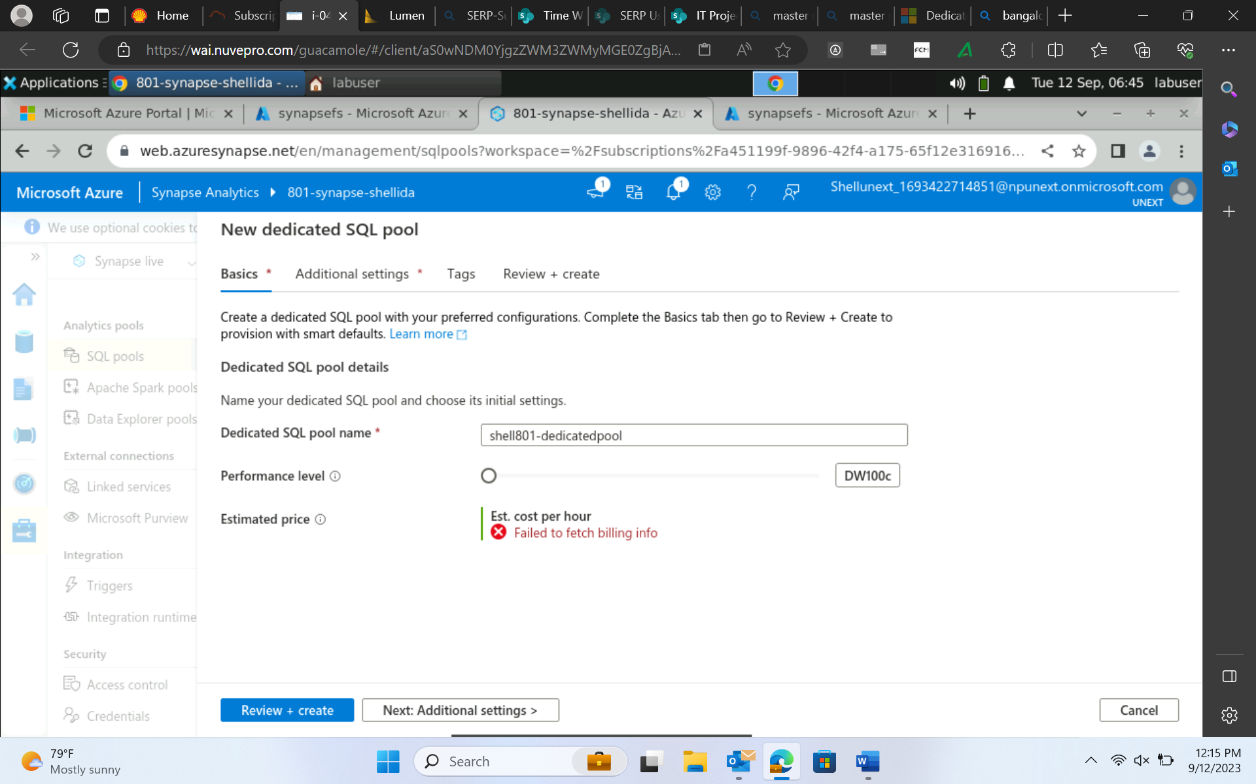
12-Sep-23 (Tuesday) – Azure Synapse Analytics
Azure Synapse → data lake storage + sql data warehouse + azure analytics
Synapse runtime is very fast.

Slide 4
13-Sep-23 (Wednesday) – Power BI
RAW → DW → Data Visualisation
Dashboard – multiple sourced interactive report
Scorecards – Align strategy
Ad-hoc reports – the instant reports
Time series – financial report
Steps :
1. Data ingestion
2. Data preparation
3. Data Modeling → designing
4. Power query editor → cleansing, missing, add new column
5. Visuals → report and dashboard

Slide 5
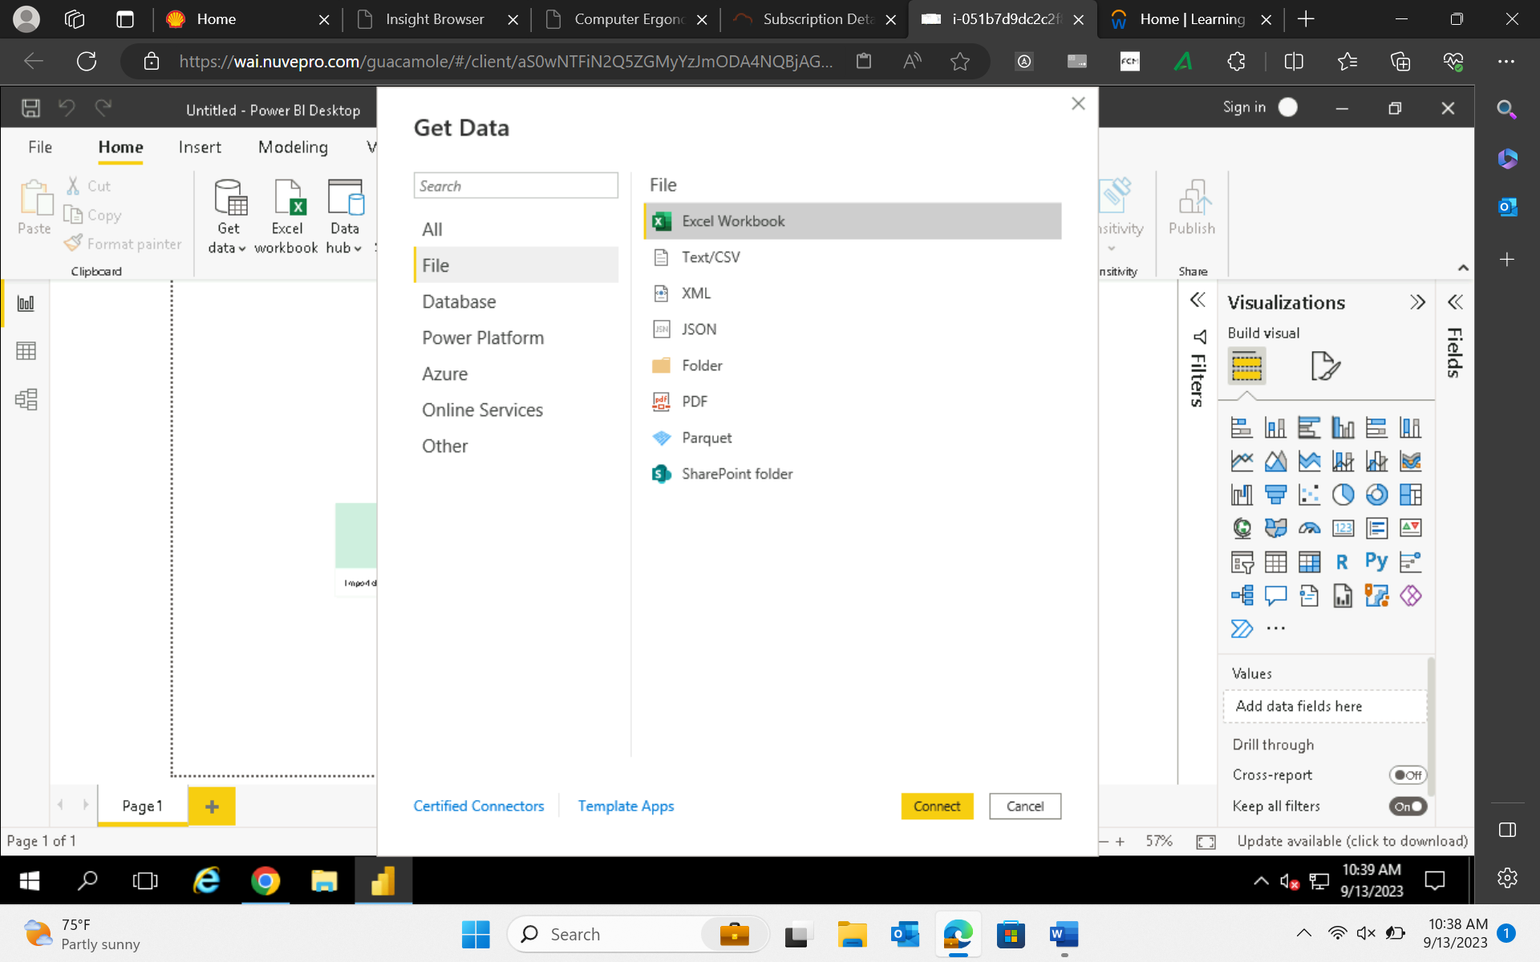
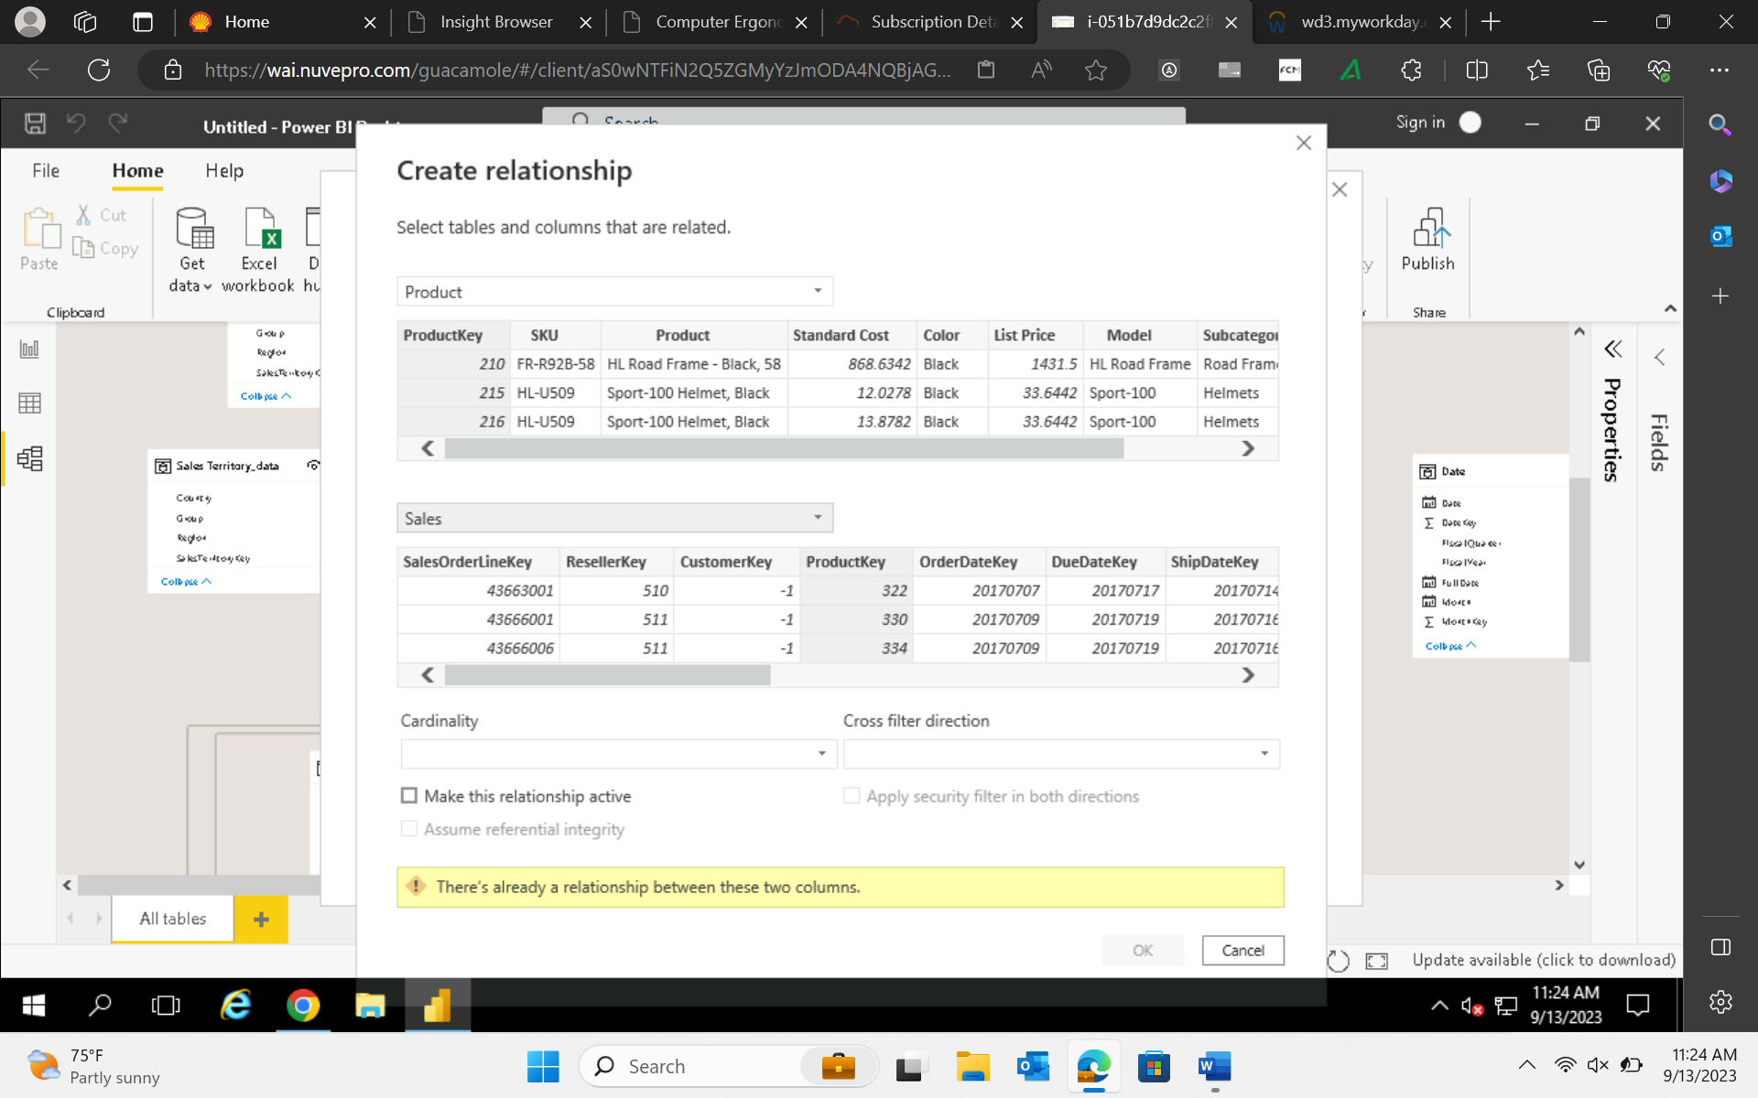
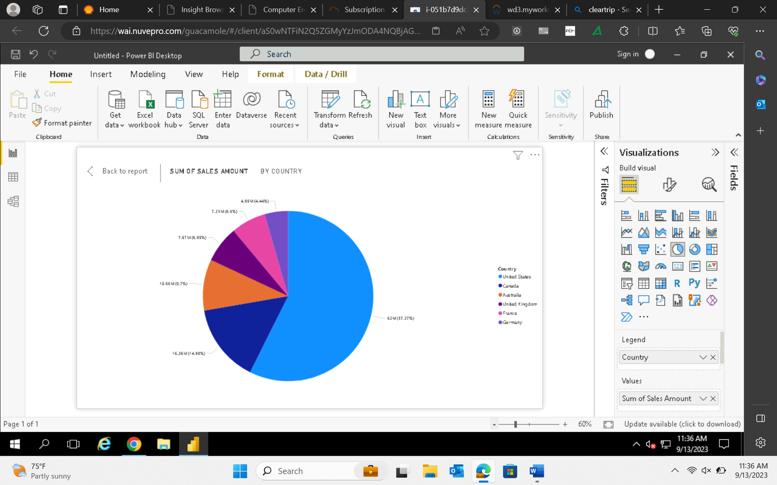
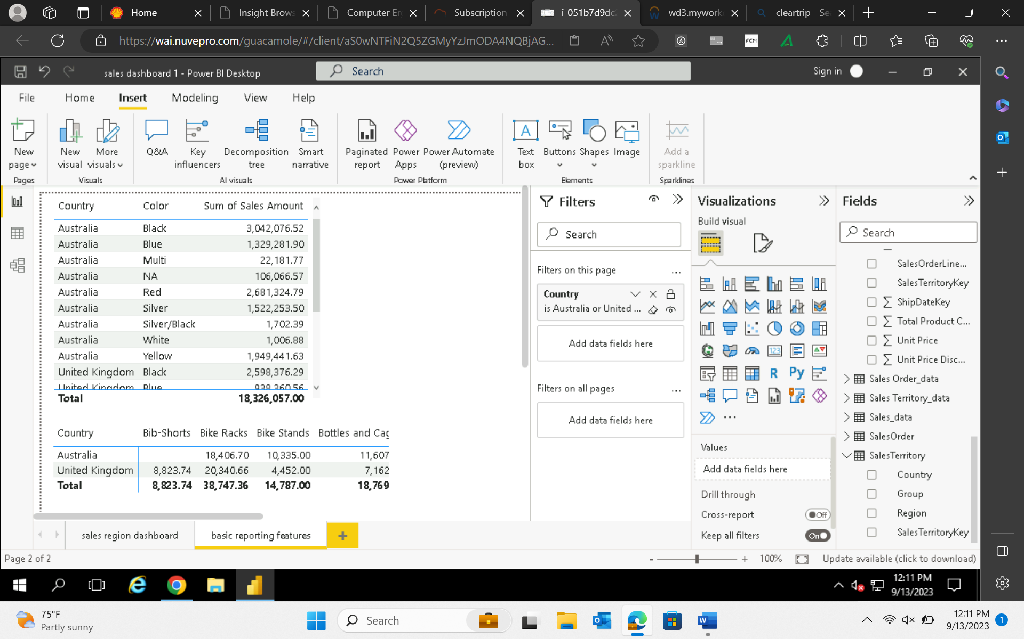
13-Sep-23 (Wednesday) – Power BI

Slide 6
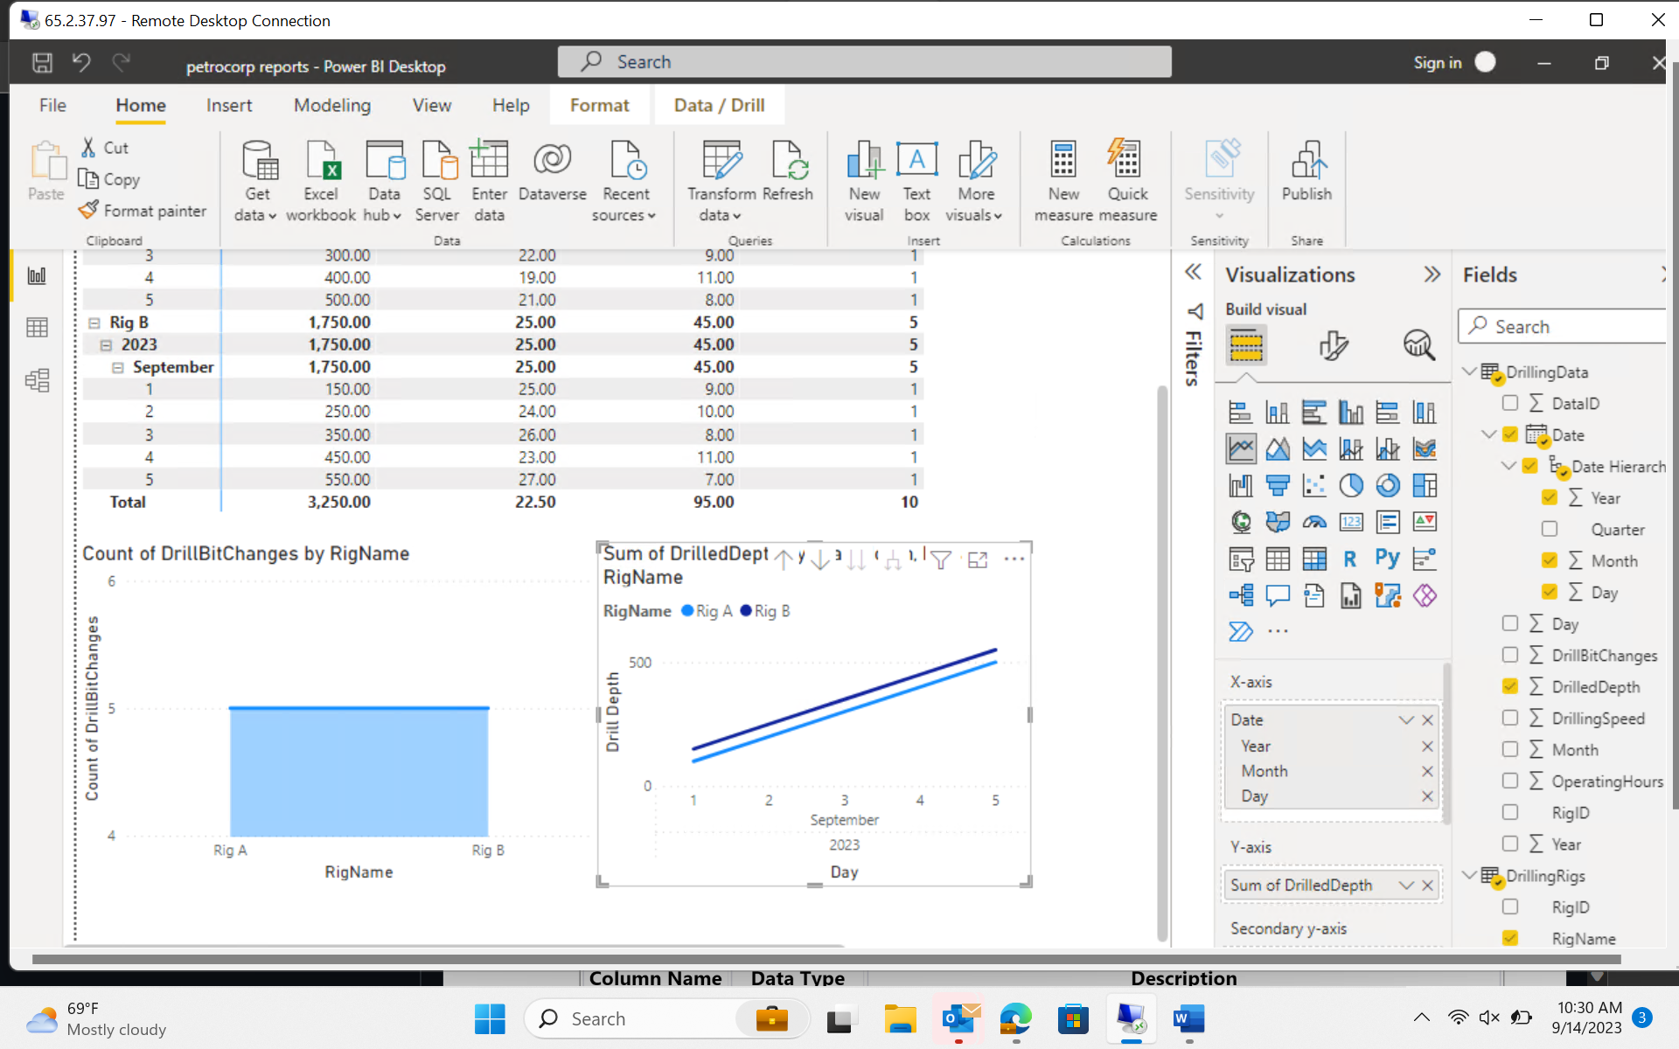
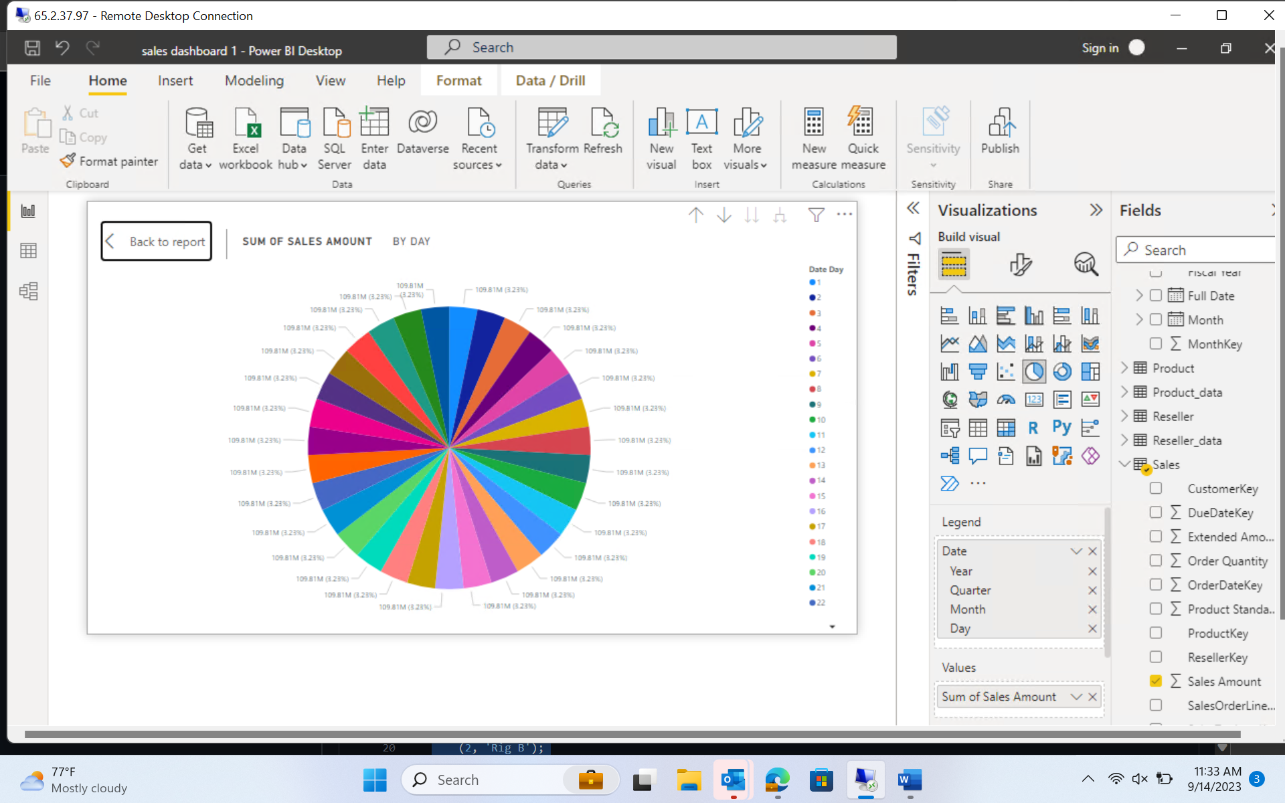
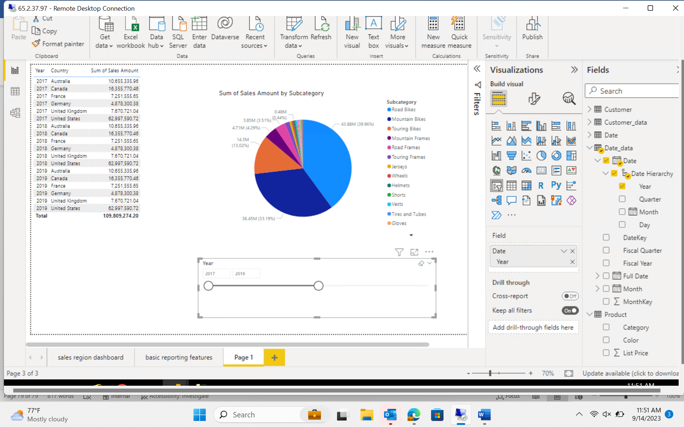
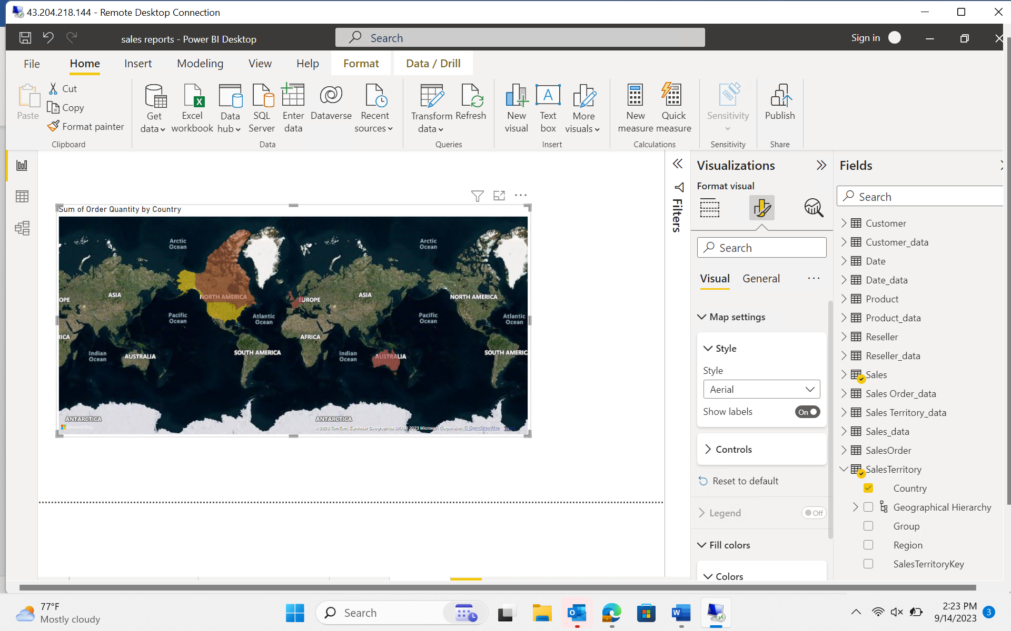
14-Sep-23 (Thursday) – Power BI Cont…

Slide 7
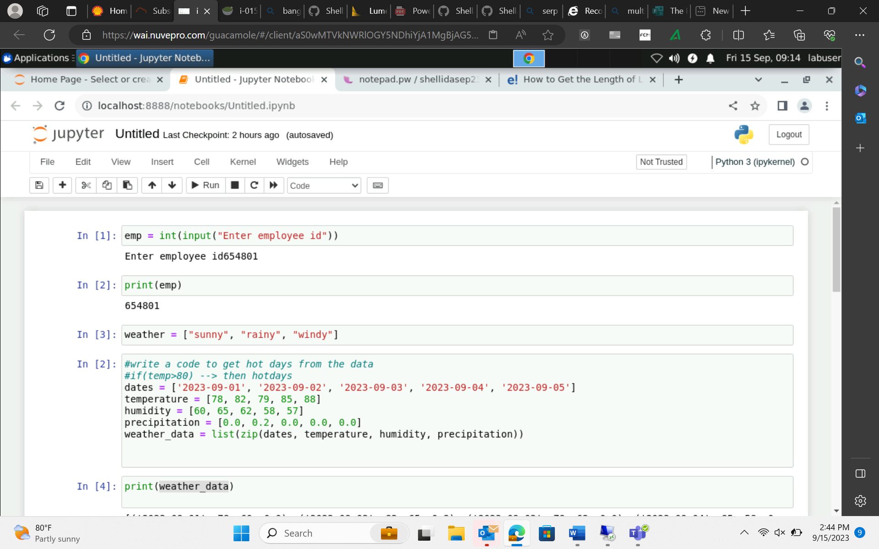
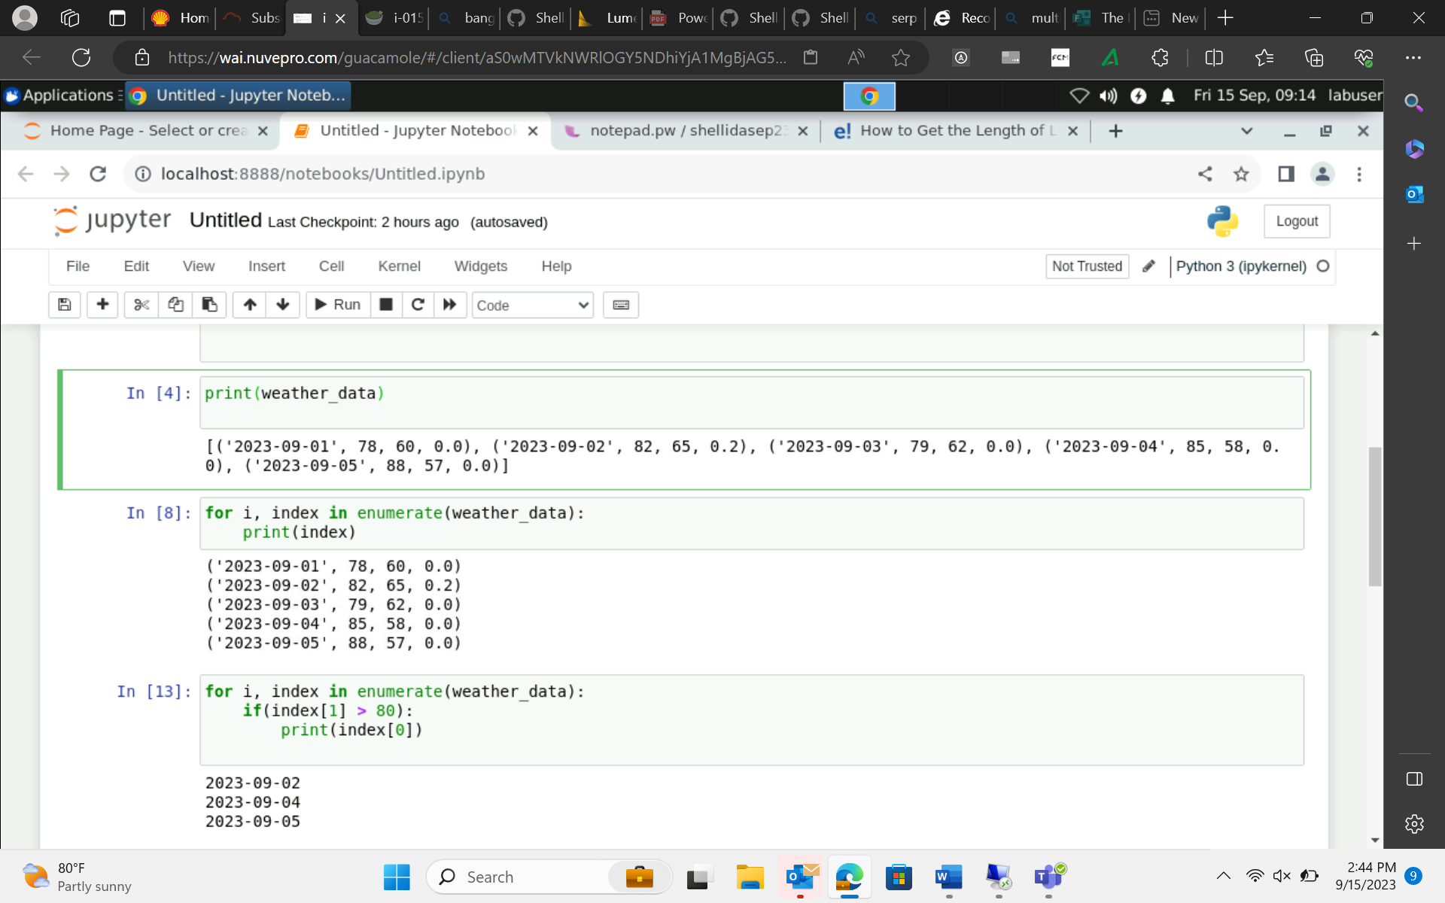
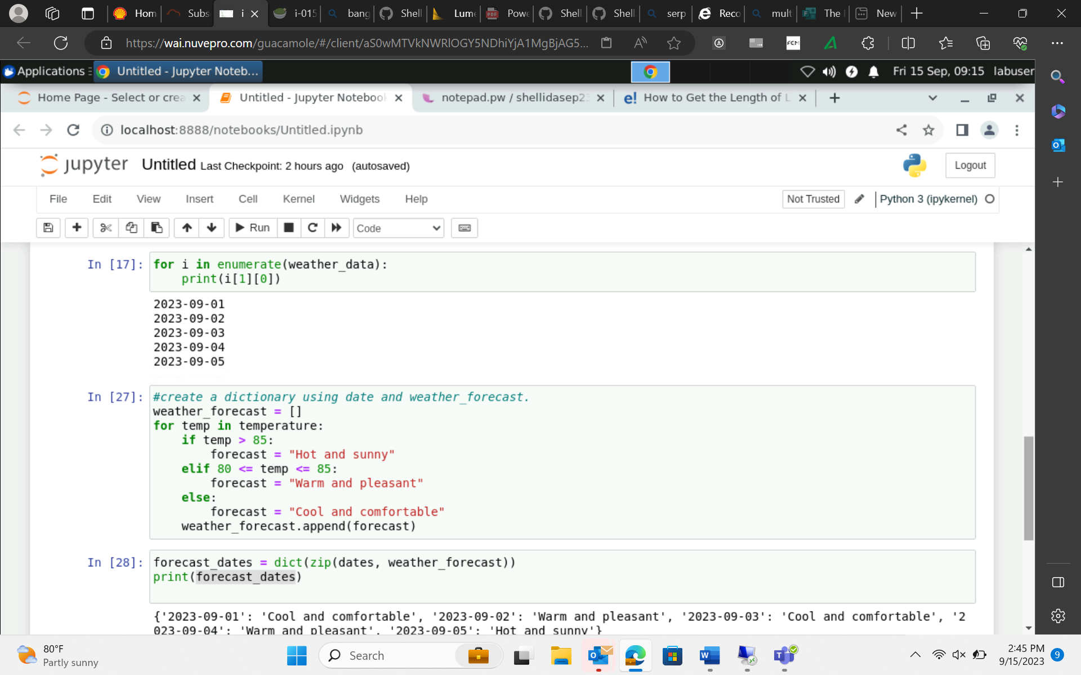
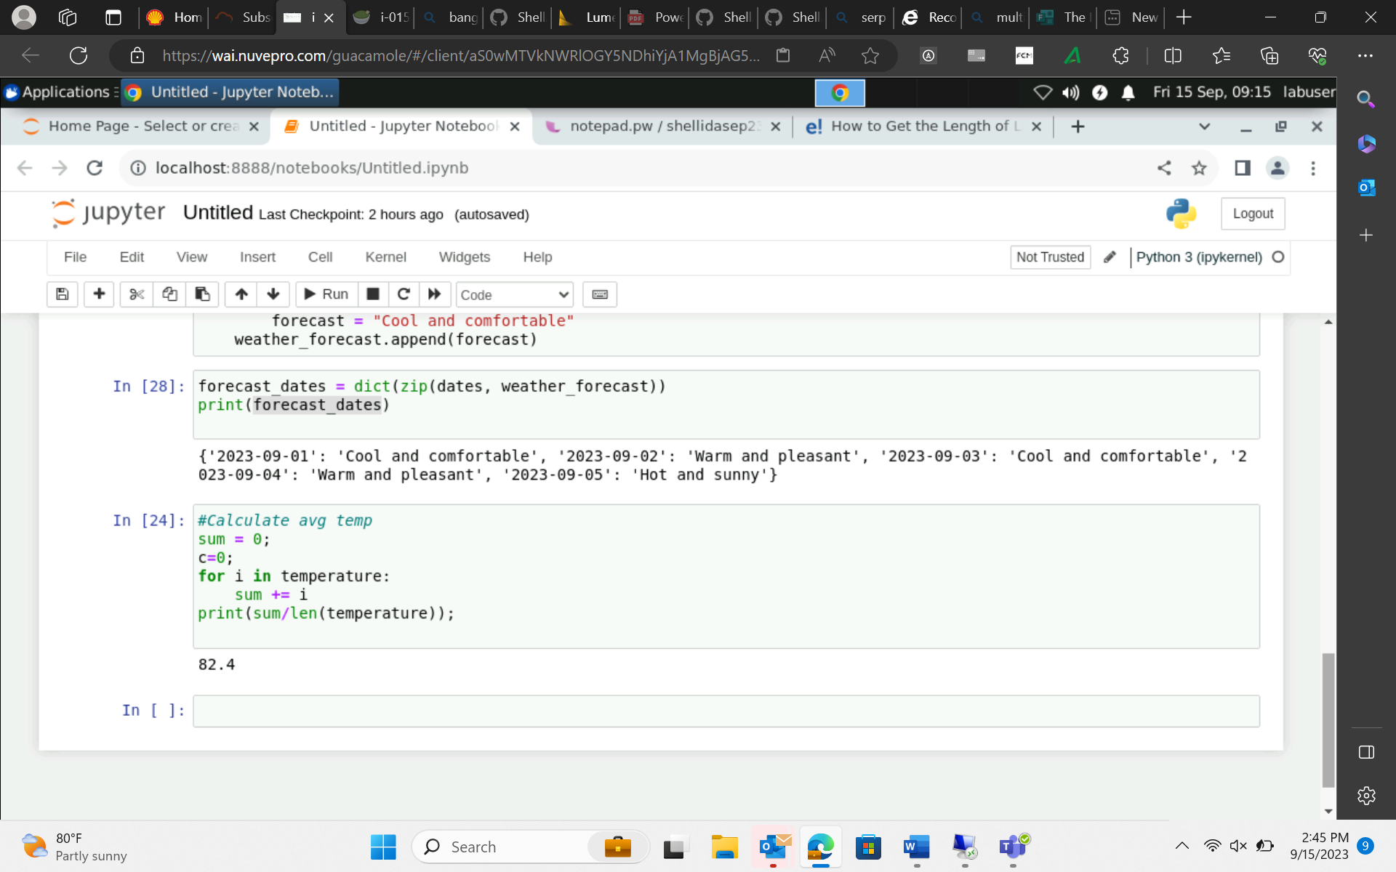
15-Sep-23 (Friday) – Python

